Slide 1

Product demand prediction with machine learning

Slide 2
Data collection
Data Collection Data collection is the process of gathering and measuring information on variables of interest, in an established systematic fashion that enables one to answer stated research questions, test hypotheses, and evaluate outcomes.

Slide 3
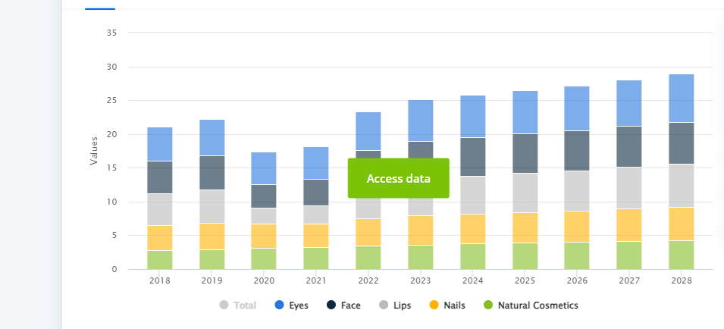
Data about sales of cosmetics in2018-2028

Slide 4
Data preprocessing
Clean and preprocess the data
Handle missing values
Convert categorical features into numerical representation

Slide 5
DATA PREPROCESSING
Data preprocessing, a component of data preparation, describes any type of processing performed on raw data to prepare it for another data processing procedure. It has traditionally been an important preliminary step for the data mining process. More recently, data preprocessing techniques have been adapted for training machine learning models and AI models and for running inferences against them.
Data preprocessing transforms the data into a format that is more easily and effectively processed in data mining, machine learning and other data science tasks. The techniques are generally used at the earliest stages of the machine learning and AI development pipeline to ensure accurate results.

Slide 6
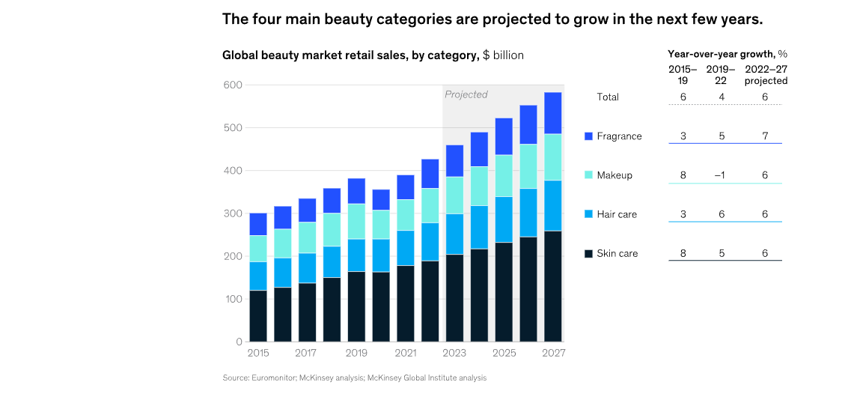
FEATURE ENGINEERING

Slide 7
MODEL SELECTION
There are some regression algorithms are present
Linear regression
Random forest
XGboost

Slide 8
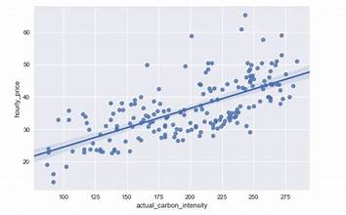
Linear regression
In statistics, linear regression is a linear approach for modelling the relationship between a scalar response and one or more explanatory variables (also known as dependent and independent variables). The case of one explanatory variable is called simple linear regression; for more than one, the process is called multiple linear regression.^{[1]} This term is distinct from multivariate linear regression, where multiple correlated dependent variables are predicted, rather than a single scalar variable

Slide 9
RANDOM FOREST
Random forests or random decision forests is an ensemble learning method for classification, regression and other tasks that operates by constructing a multitude of decision trees at training time. For classification tasks, the output of the random forest is the class selected by most trees. For regression tasks, the mean or average prediction of the individual trees is returned.^{[1}

Slide 10
XG BOOST
XGBoost^{[2]} (eXtreme Gradient Boosting) is an open-source software library which provides a regularizing gradient boosting framework for C++, Java, Python,^{[3]} R,^{[4]} Julia,^{[5]} Perl,^{[6]} and Scala. It works on Linux, Windows,^{[7]} and macOS.^{[8]} From the project description, it aims to provide a "Scalable, Portable and Distributed Gradient Boosting (GBM, GBRT, GBDT)

Slide 11
EVALUATION
What is Mean Absolute Error or MAE
Mean Absolute Error(MAE) is the mean size of the mistakes in collected predictions. We know that an error basically is the absolute difference between the actual or true values and the values that are predicted. The absolute difference means that if the result has a negative sign, it is ignored.
What is Mean Squared Error or MSE
The Mean Absolute Error is the squared mean of the difference between the actual values and predictable values.

Slide 12
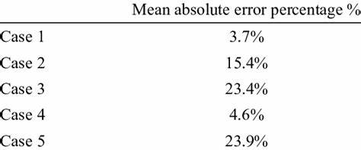
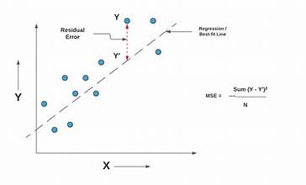
MEAN ABSOLUTE ERROR ,MEAN SQUARED ERROR

Slide 13
THANK YOU

